Slide 1

Scam Guard: AI-ELDER- FINANCE-PROTECTOR
Safeguarding our seniors from digital fraud through intelligent, real-time detection and family collaboration.
TEAM NAME : CODEORBIT
TEAM MEMBERS
M HITHESH KUMAR M.BHAVYA SREE D.DIVYA SREE

Slide 2
Why Elderly Users Need Protection
The Growing Threat
Common Attack Vectors
Elderly individuals face a barrage of sophisticated scams daily:
Fraudulent SMS messages claiming urgent bank issues
Deceptive WhatsApp communications
Phishing emails mimicking trusted organisations
Voice calls requesting OTPs or direct payments
Vulnerability Factors
Seniors struggle to identify threats because they:
Cannot recognise evolving scam patterns
Respond to fear-based, urgent messaging Misinterpret suspicious links
Trust unfamiliar numbers and senders
Financial Loss
Life savings compromised through digital fraud
Emotional Distress
Anxiety and loss of digital confidence
Delayed Discovery
Families often unaware until significant damage occurs

Slide 3


Introducing Scam Guard: Real- Time AI Protection
Intelligent Monitoring
Analyses incoming messages through manual input in prototype
phase, with automated scanning planned for future releases.
AI-Powered Detection
Advanced algorithms identify scam patterns, suspicious language,
and fraudulent indicators with exceptional accuracy.
Clear Risk Classification
Messages categorised as Safe, Warning, or Scam with simple
explanations: "This message may be a scam because..."
Senior-Friendly Interface
Clean, intuitive design with large text and clear navigation
optimised specifically for elderly users.

Slide 4
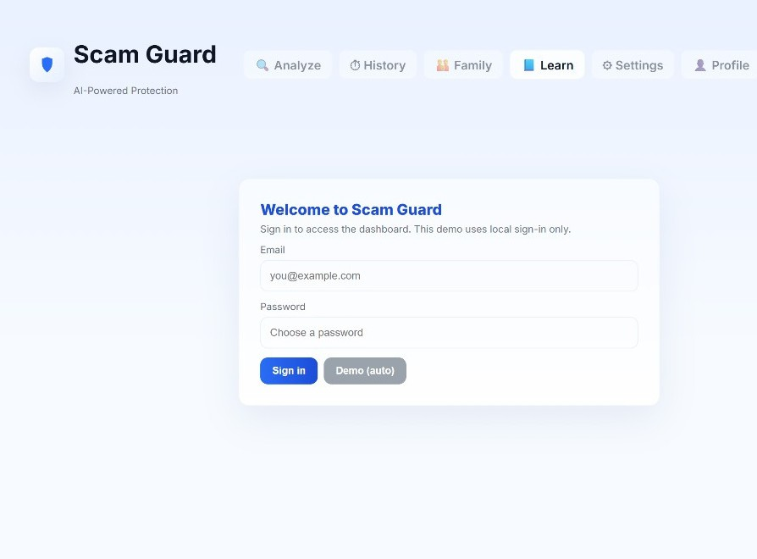
System Overview: What We've Built
Comprehensive Platform Features
Scam Guard provides AI-powered protection through an accessible web-based platform.
Analyse: Real-time message scanning and risk assessment
History: Track all analysed messages and patterns Family: Collaborative protection with alert sharing Learn: Educational resources for scam awareness Settings: Customisable preferences and notifications Profile: Personal dashboard and account management The prototype includes secure login, demo mode for testing, and a clean pastel-themed interface designed for clarity and ease of use.

Slide 5
Core Capabilities That Protect
AI Scam Detection Identifies phishing attempts, fraud messages, urgency tones, and suspicious keywords using advanced NLP classification. Provides simple, jargon-free explanations that elderly users can understand and act upon.
History Tracking Maintains comprehensive records of all analysed messages, allowing users to review past communications and identify emerging scam trends over time.
Family Mode Enables trusted family members to monitor alerts and intervene early when potential threats are detected, creating a safety net of support.
Learning Module Educates seniors on identifying common scam tactics through easy-to-digest awareness materials, building long-term digital literacy and confidence.

Slide 6




How Detection Works Behind the Scenes
Message Input
System extracts and processes text from incoming communications
Pattern Analysis
AI examines urgency indicators, money requests, OTP demands, fraud links, and sender authenticity
Detection Features: The system combines rule- based algorithms with GPT-powered NLP logic to identify keywords like "urgent", "immediately", "click now", along with patterns requesting sensitive information or payments from unknown sources.
Classification
Generates risk score and label: Safe, Suspicious, or Scam with clear reasoning

Slide 7
User Journey: Step-by-Step Protection
Access Platform
User opens Scam Guard and authenticates
via login or demo mode
1
2
Navigate to Analysis
Opens the Analyse page from the main
dashboard
Submit Message
Enters or uploads suspicious message for
evaluation
3
4
AI Processing
System analyses content using multi-
layered detection algorithms
Receive Results
View scam classification, risk score, and
plain-language explanation
5
6
Auto-Save & Alert
Results saved to History; Family Dashboard
notified if threat detected

Slide 8


Technology Stack Powering Protection
Frontend
Technologies: HTML, CSS, JavaScript, React
Responsive, accessible design with pastel theming optimised for senior users
Backend
Framework: Python Flask / Node.js
Robust API structure handling message processing and user management
AI & NLP
Engine: GPT integration with rule-based analysis
Keyword vector checks and sophisticated scam pattern recognition
Data Storage
Solution: Local JSON / Firebase
Prototype uses secure local storage with cloud expansion planned

Slide 9
What Makes Scam Guard Innovative
Simple Explanations
Translates complex scam indicators into clear, understandable language for elderly users
Family Collaboration
Unique dashboard allowing trusted relatives to monitor and respond to threats
Educational Approach
Built-in learning materials that empower seniors with long-term digital safety skills
Senior-First Design
Every interface element specifically crafted for elderly usability and accessibility
Multichannel Ready
Architecture designed for expansion across SMS, WhatsApp, email, and voice calls

Slide 10
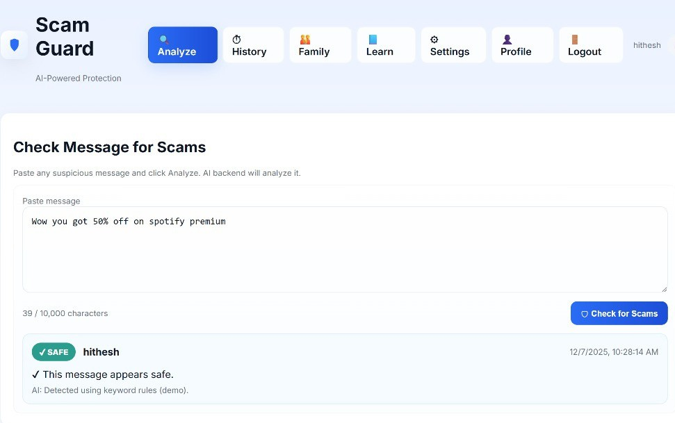
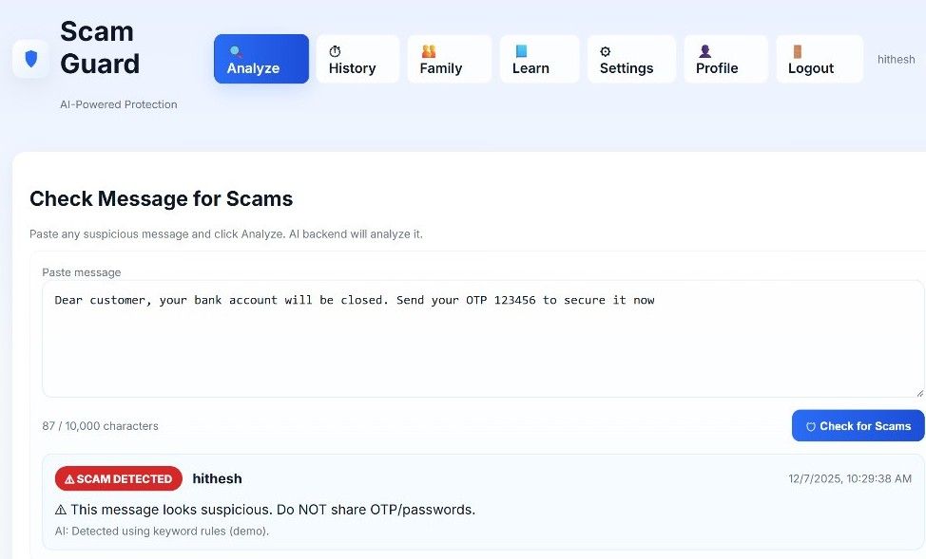
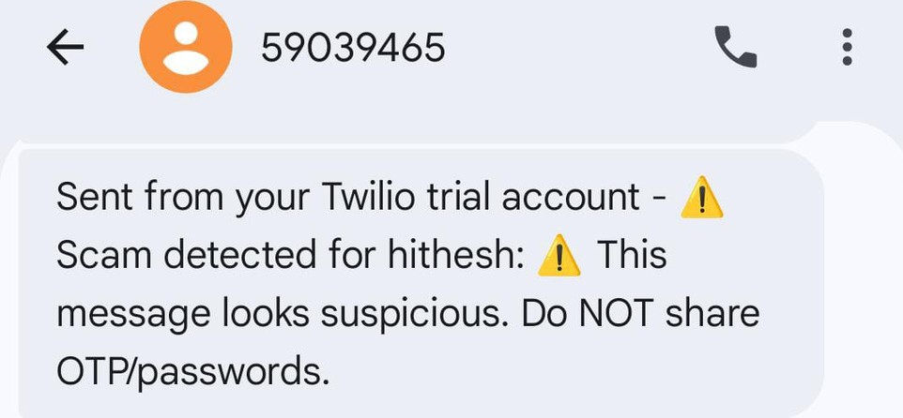
Output Screenshots

Slide 11
Results & Future Roadmap
95%
Classification Accuracy Successfully distinguishing scam from legitimate messages
Next Phase: Enhanced Protection
Automatic scanning: Real-time SMS and WhatsApp monitoring
Voice protection: AI-powered call scam
detection
Mobile app: Dedicated family member
application
4
Core Features
Detection, History, Family Mode, and Learning modules operational
Multilingual support: Warnings in regional Indian languages
Authority integration: Automatic scam
reporting to cybercrime cells
Expanded AI: Continuous learning from
new scam patterns

Slide 12

THANK YOU

